Slide 1
Signal Processing
Tirgul 0 – Re-introduction to Python

Slide 2
Some technicalities
Tal Dalal
Tuesday 14:00-16:00
Wednesday 10:00-12:00
Building 901, Room 517
Or Bashan
Tuesday 14:00-16:00
Building 901, Room 517
signalprocessbrainbiu@gmail.com
No specific meeting hours but please contact us before!

Slide 3
More technicalities
Weekly exercise:
Submission in the Moodle
Deadline is Midnight, 2 weeks after the exercise is published.
Submit the first exercise alone!, deadline: one week.
Future submissions will be in pairs. Keep the pairs constant.
The final grade will not include one (lowest/not submitted) exercise grade. The first exercise is mandatory to submit.
2. Final exam

Slide 4
Signal Processing
Subfiled in electrical engineering that focuses on analysing, modifying, and synthesizing signals such as sound, images, and scientific measurements.
Has applications in many fields such as:
Audio signal processing - such as speech or music.
Image and video processing.
Wireless communication.
Financial signal processing.
data compression.
genomic signal processing.
and much more…

Slide 5



Intro to Python: let’s begin!

Slide 6
The most important tip in programming:
Google knows everything - use it!

Slide 7
Online python interface (notebook), with no need to download any software.
operates via Google account.

Slide 8
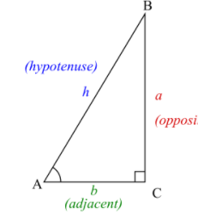
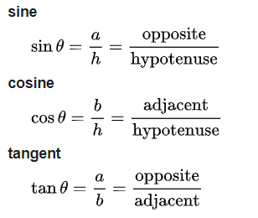
Trigonometric Functions
Real functions, relate an angle at a triangle to two side lengths. Will take a part in the course.
The most basic functions are:

Slide 9
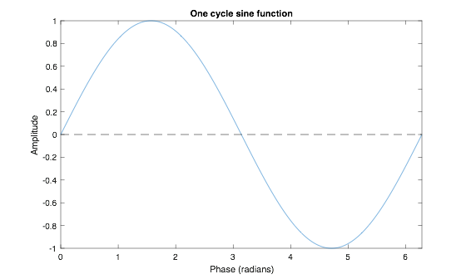
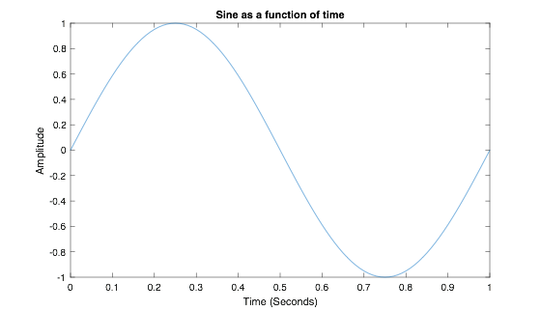
Sine:

Slide 10
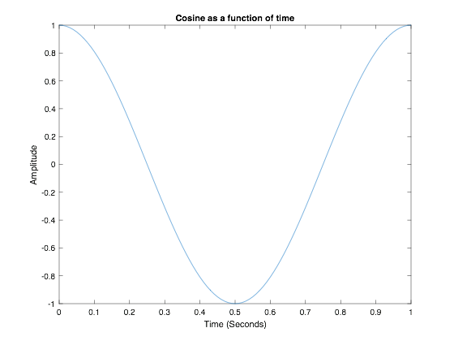
Plot the cosine wave

Slide 11
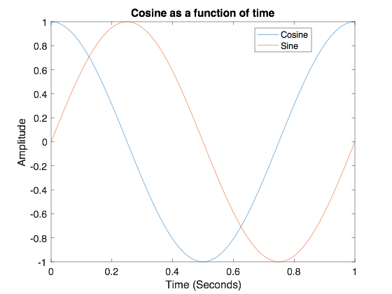
Plot both waves

